Slide 1
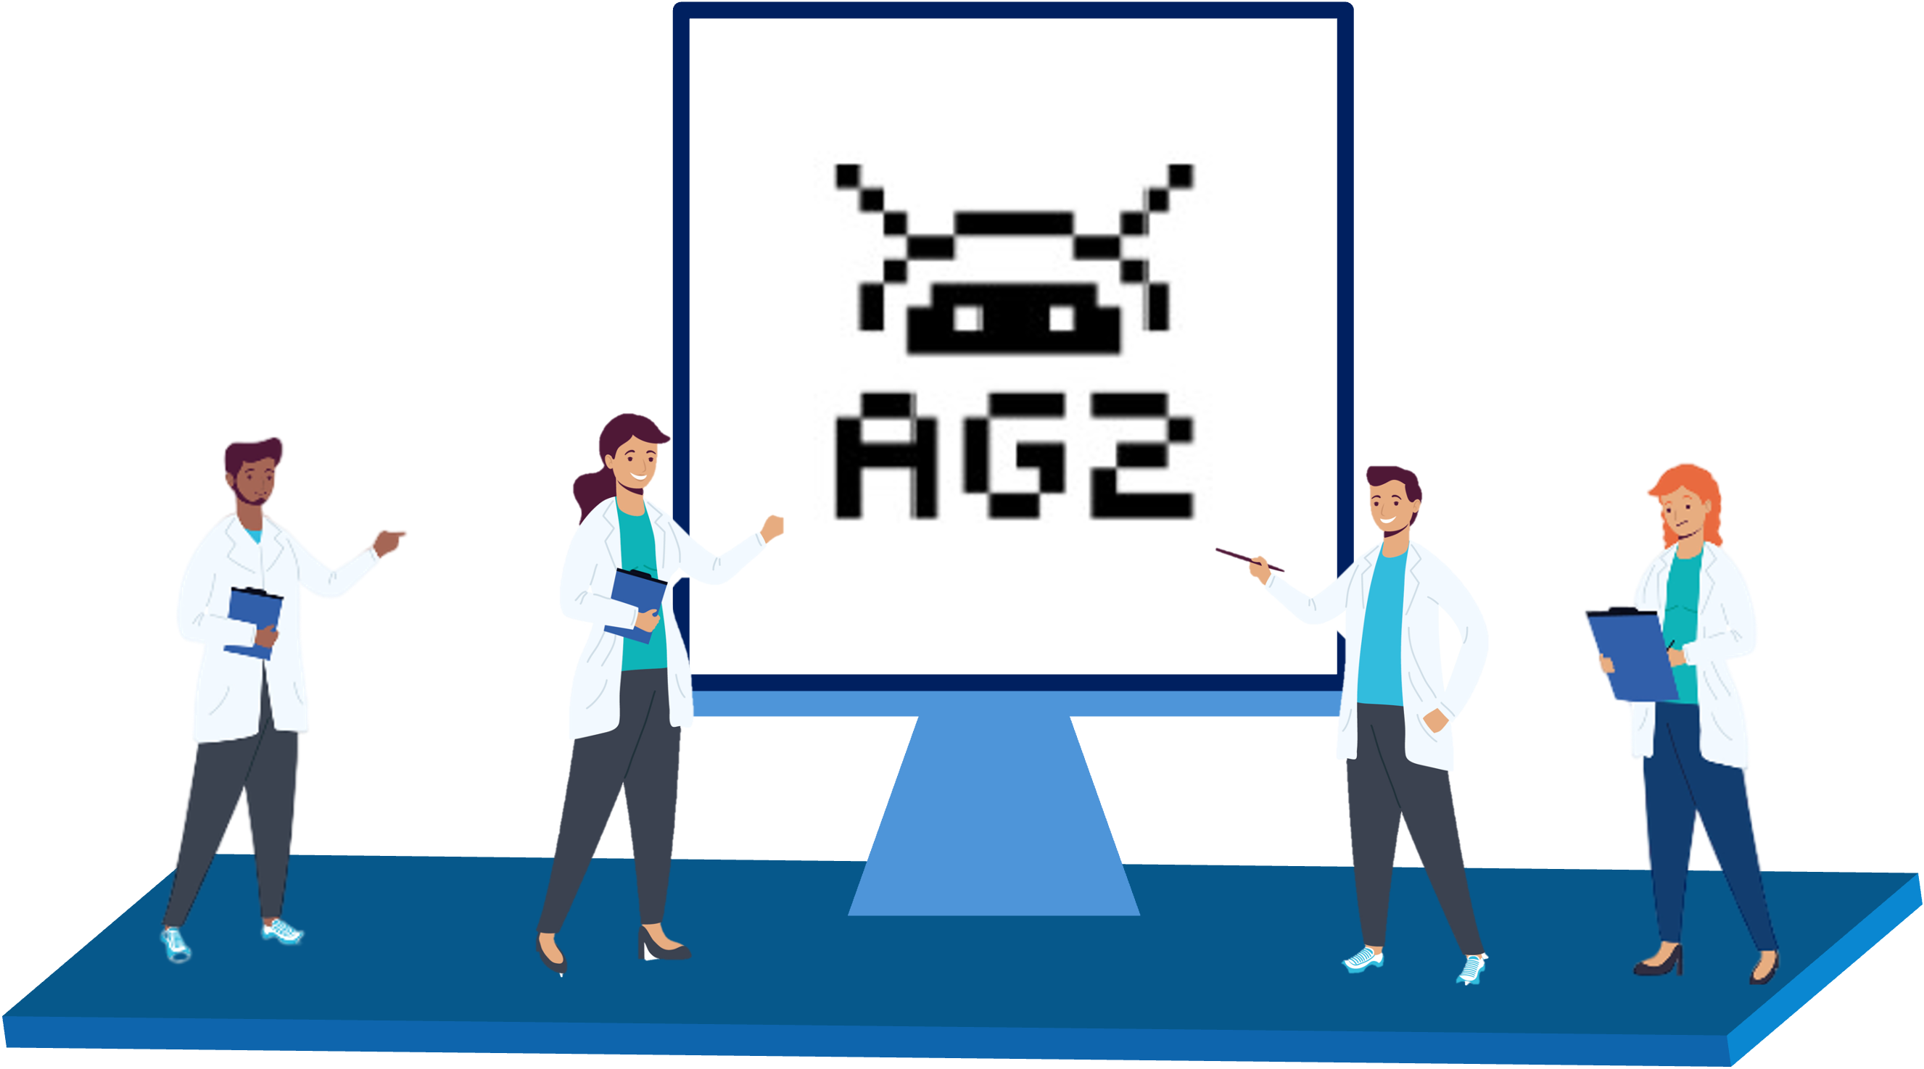

Sharif LLM Agent Hackathon
May 28th, 2025
Building LLM-powered
multiagent systems with AG2
Alireza Ghafarollahi
Massachusetts Institute of Technology
Notes:
Thank you very much. I am very excited to be here today.
Before I start, I would like to take this moment to thank Professors Bill Curtin and Markus Buehler, my PhD and postdoctoral advisors, for their invaluable support and guidance.

Slide 2
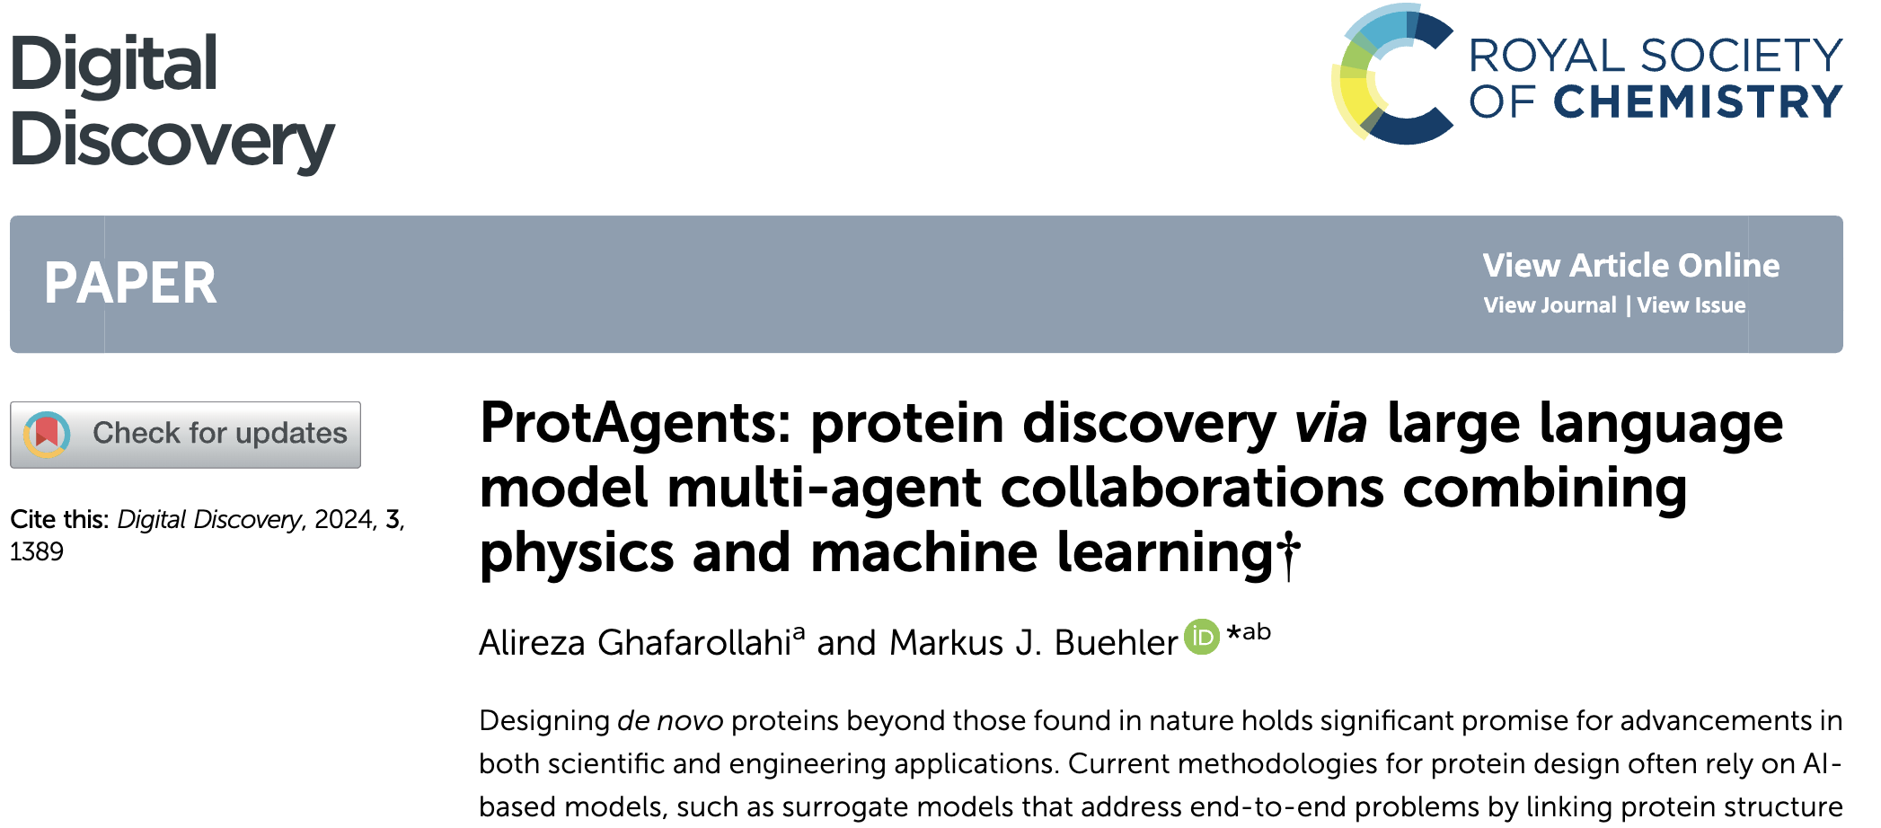
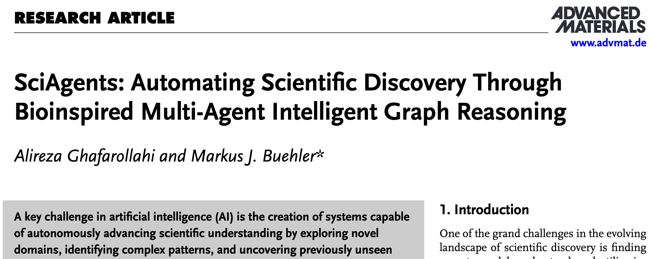
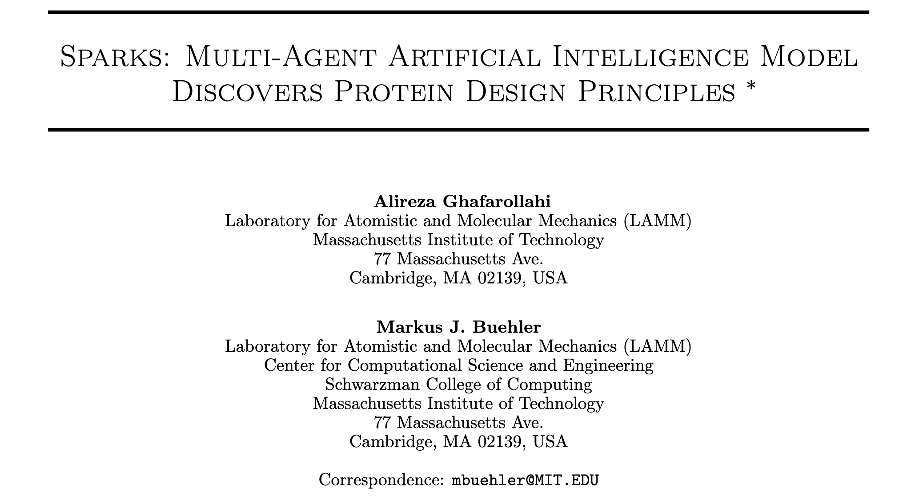
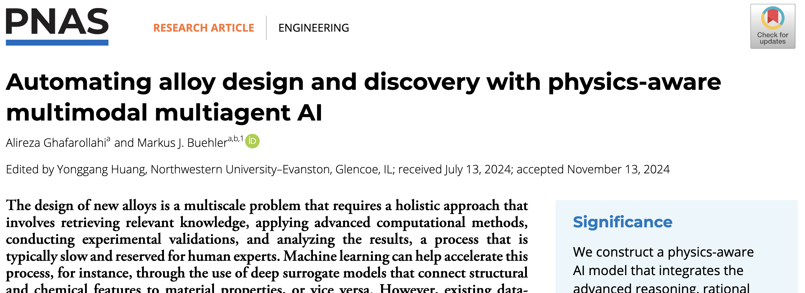

Slide 3
Overview
Build your first multi-agent system
A pre-programmed multi-agent system with Python
Fully automated multi-agent system (AG2)
Basic Concepts
LLM Configuration
ConversableAgent
Human in the Loop
Agent Orchestration
Tools
Agent Orchestration Deep Dive
Two Agent Chat
Sequential Chat
Group Chats
Tools and functions
Context Variables
Handoffs
Orchestration Patterns (if time allowed)

Slide 4
Build your first multi-agent system with AG2 Python

Slide 5
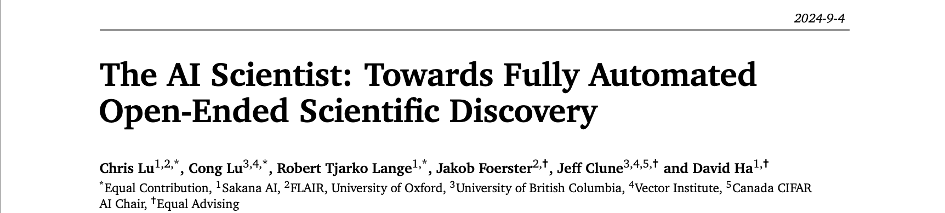
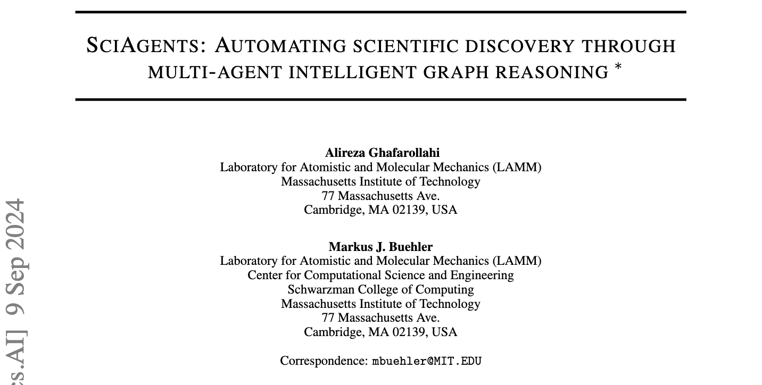
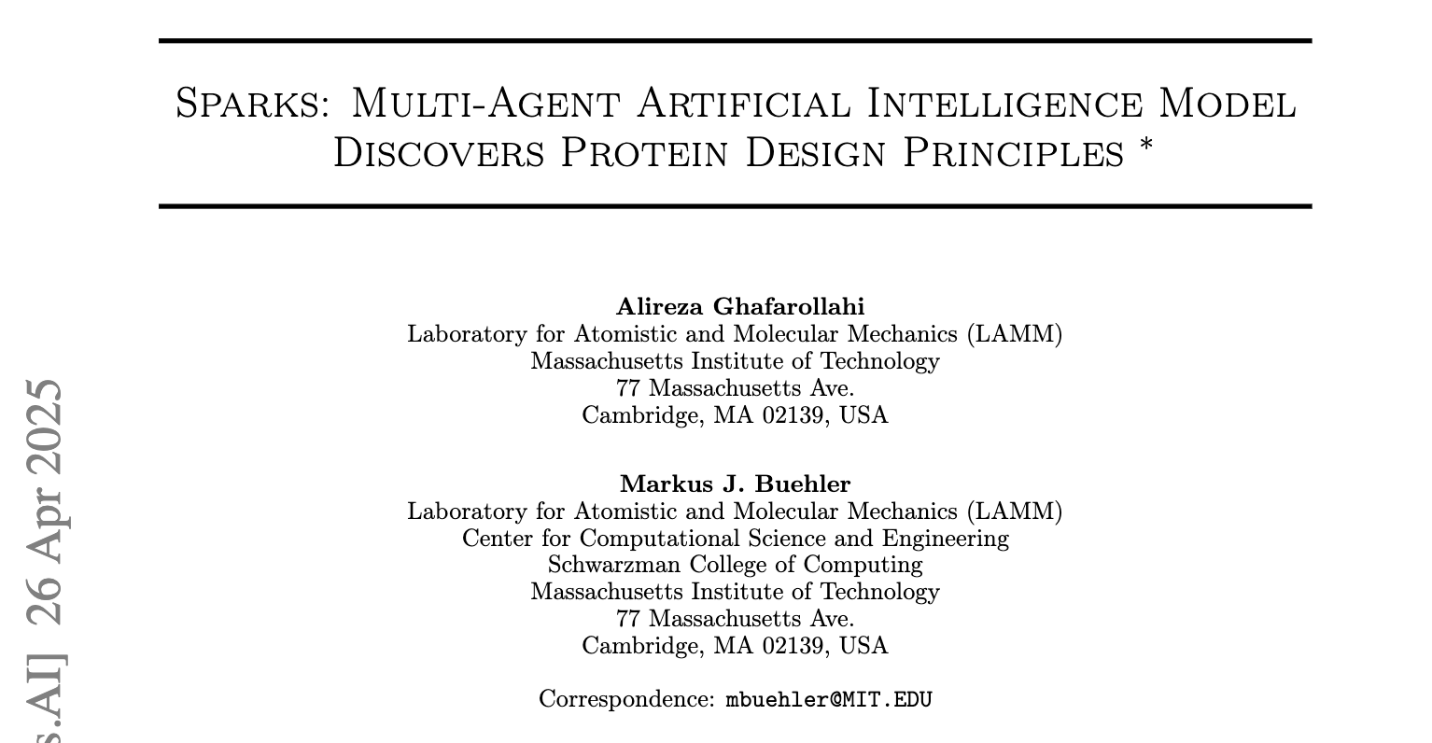
A pre-programmed multi-agent system with Python
Pre-programmed sequence of interactions between agents
More consistency and reliability
Less flexibility
No human in the loop

Slide 6
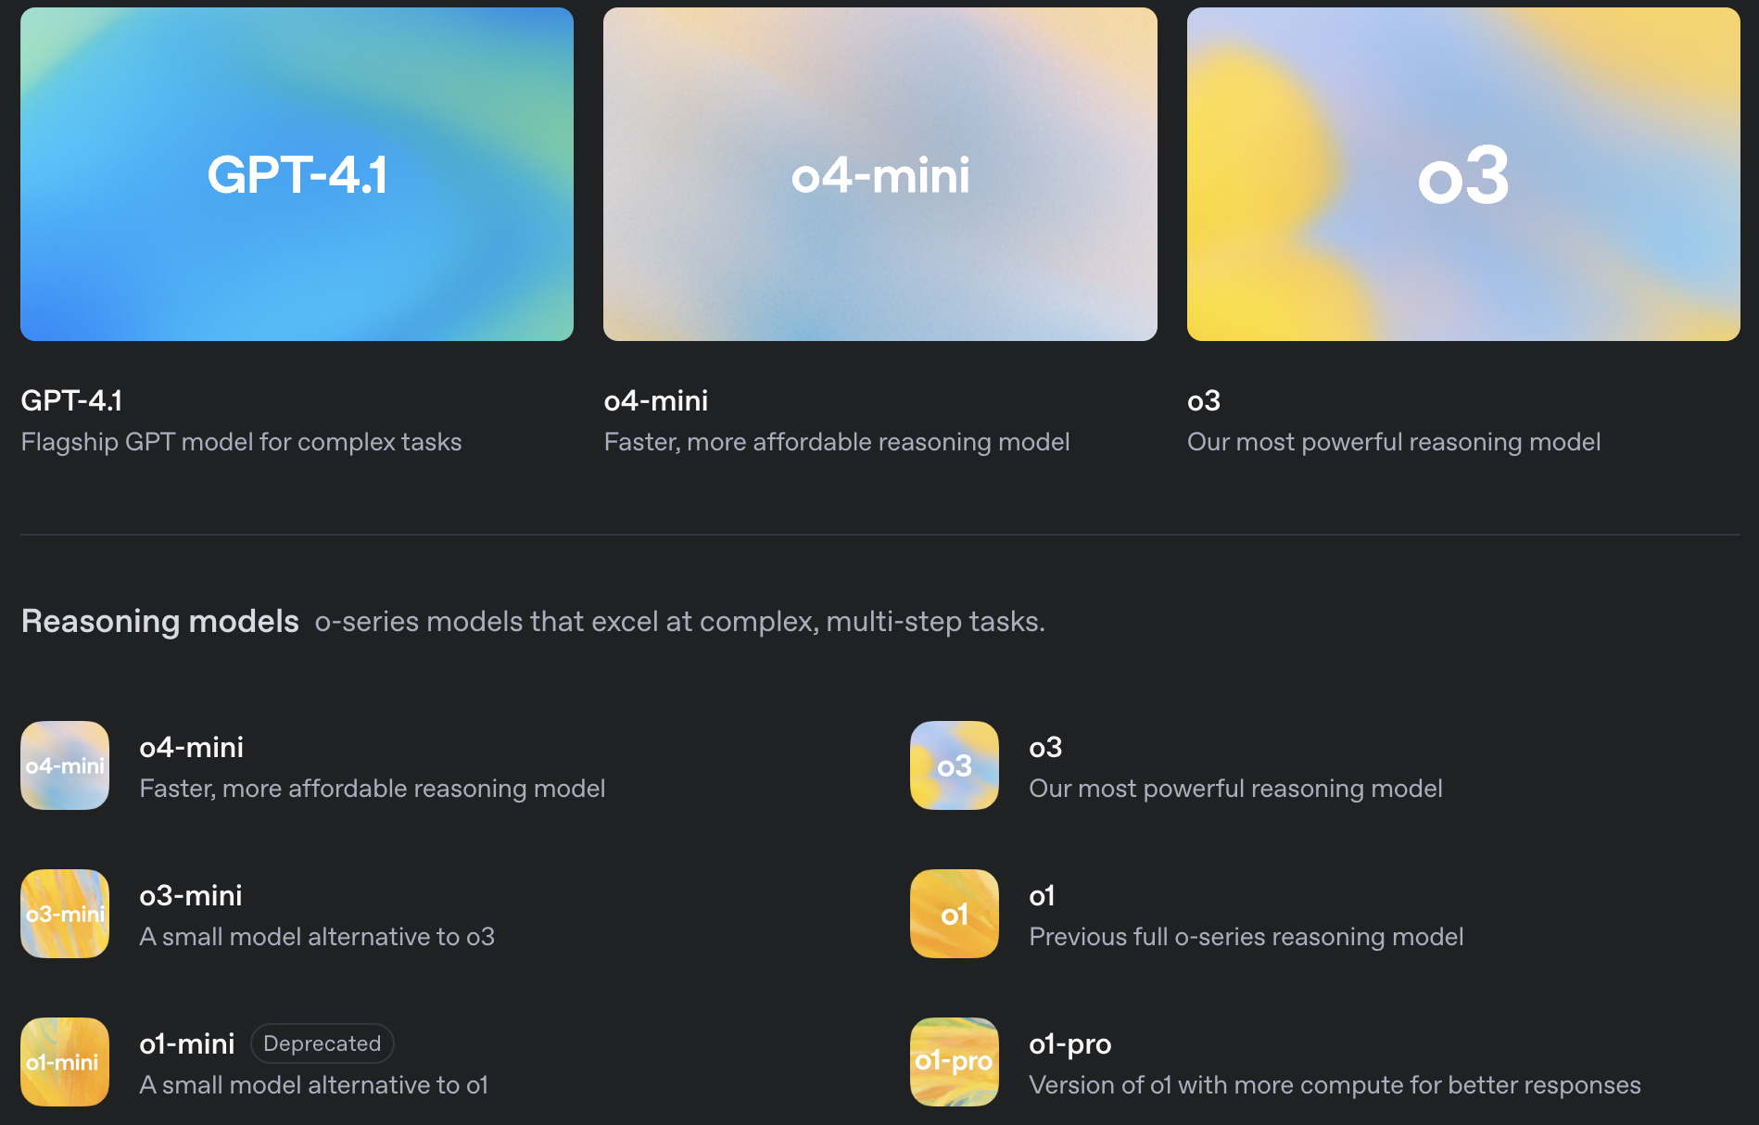
Building your first agent
Agents use LLMs as key components to understand and react
OpenAI models
client = OpenAI()
response = client.chat.completions.create(
model,
messages,
temperature,
max_completion_tokens,
)
content = response.choices[0].message.content

Slide 7
Building your first agent
messages=[
{“role”: “user”, “content”: “prompt_1”}
]
prompt
agent’s profile
+
user’s query
messages
msg_history
response

Slide 8
Now let’s add another agent that interacts with the first agent
messages=[
{“role”: “user”, “content”: “prompt_1”},
{“role”: “assistant”, “content”: “response_1”},
{“role”: “user”, “content”: “prompt_2”},]
msg_history
msg_history (old prompt+old response)
messages
msg_history
new prompt
new response

Slide 9
AG2: Building fully automated multi-agent systems

Slide 10
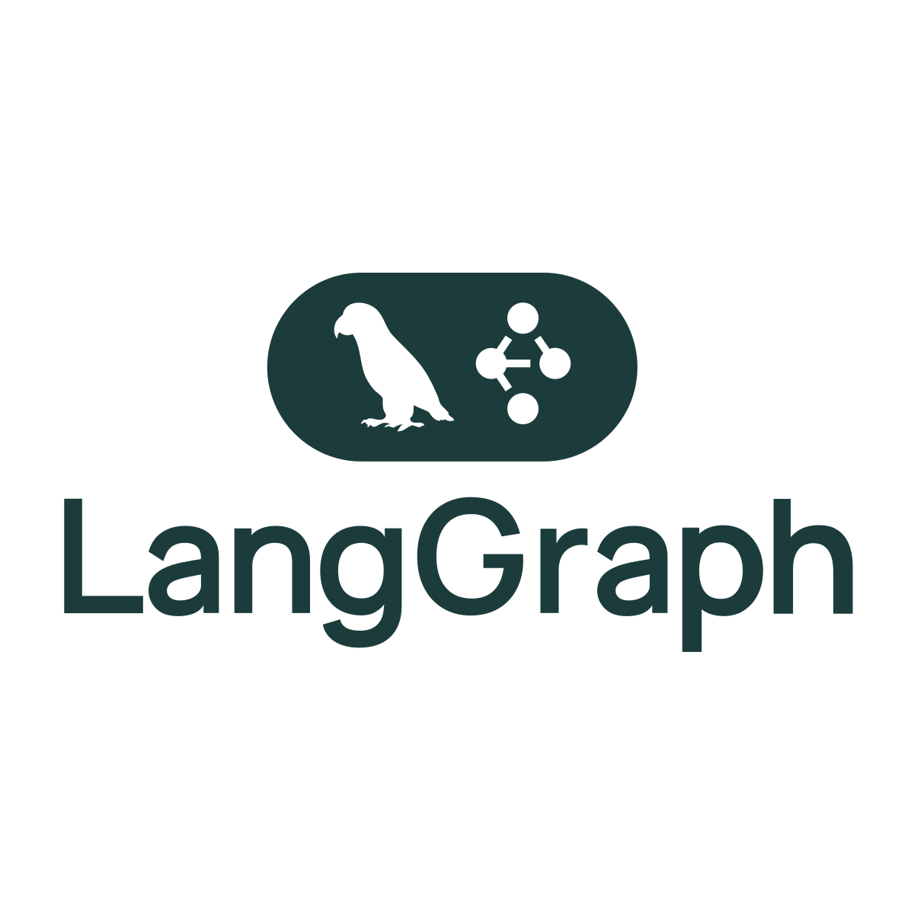
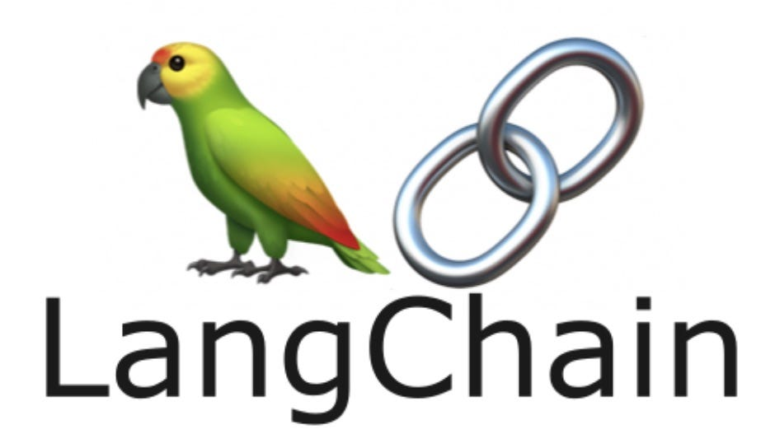

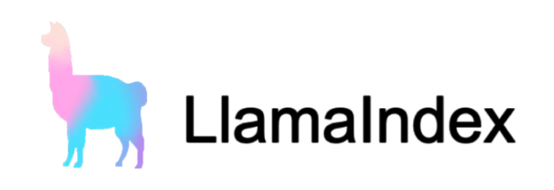

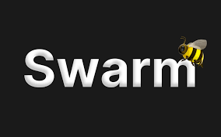

Multi-agent frameworks

Slide 11
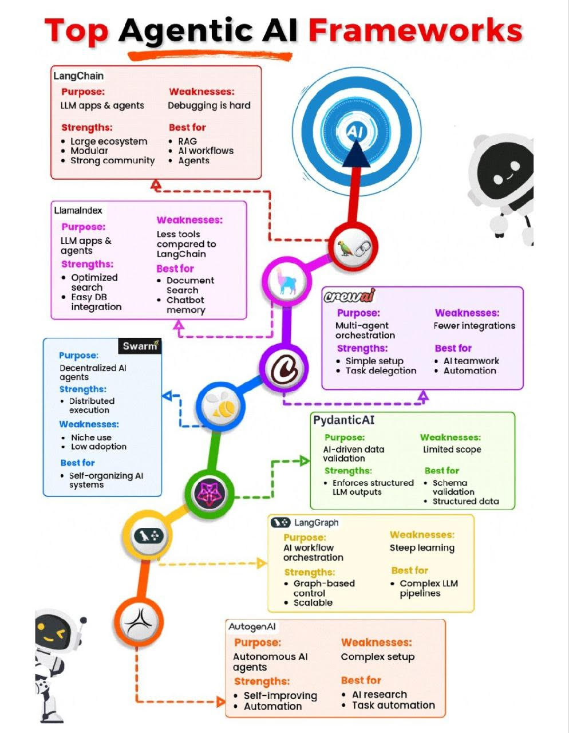
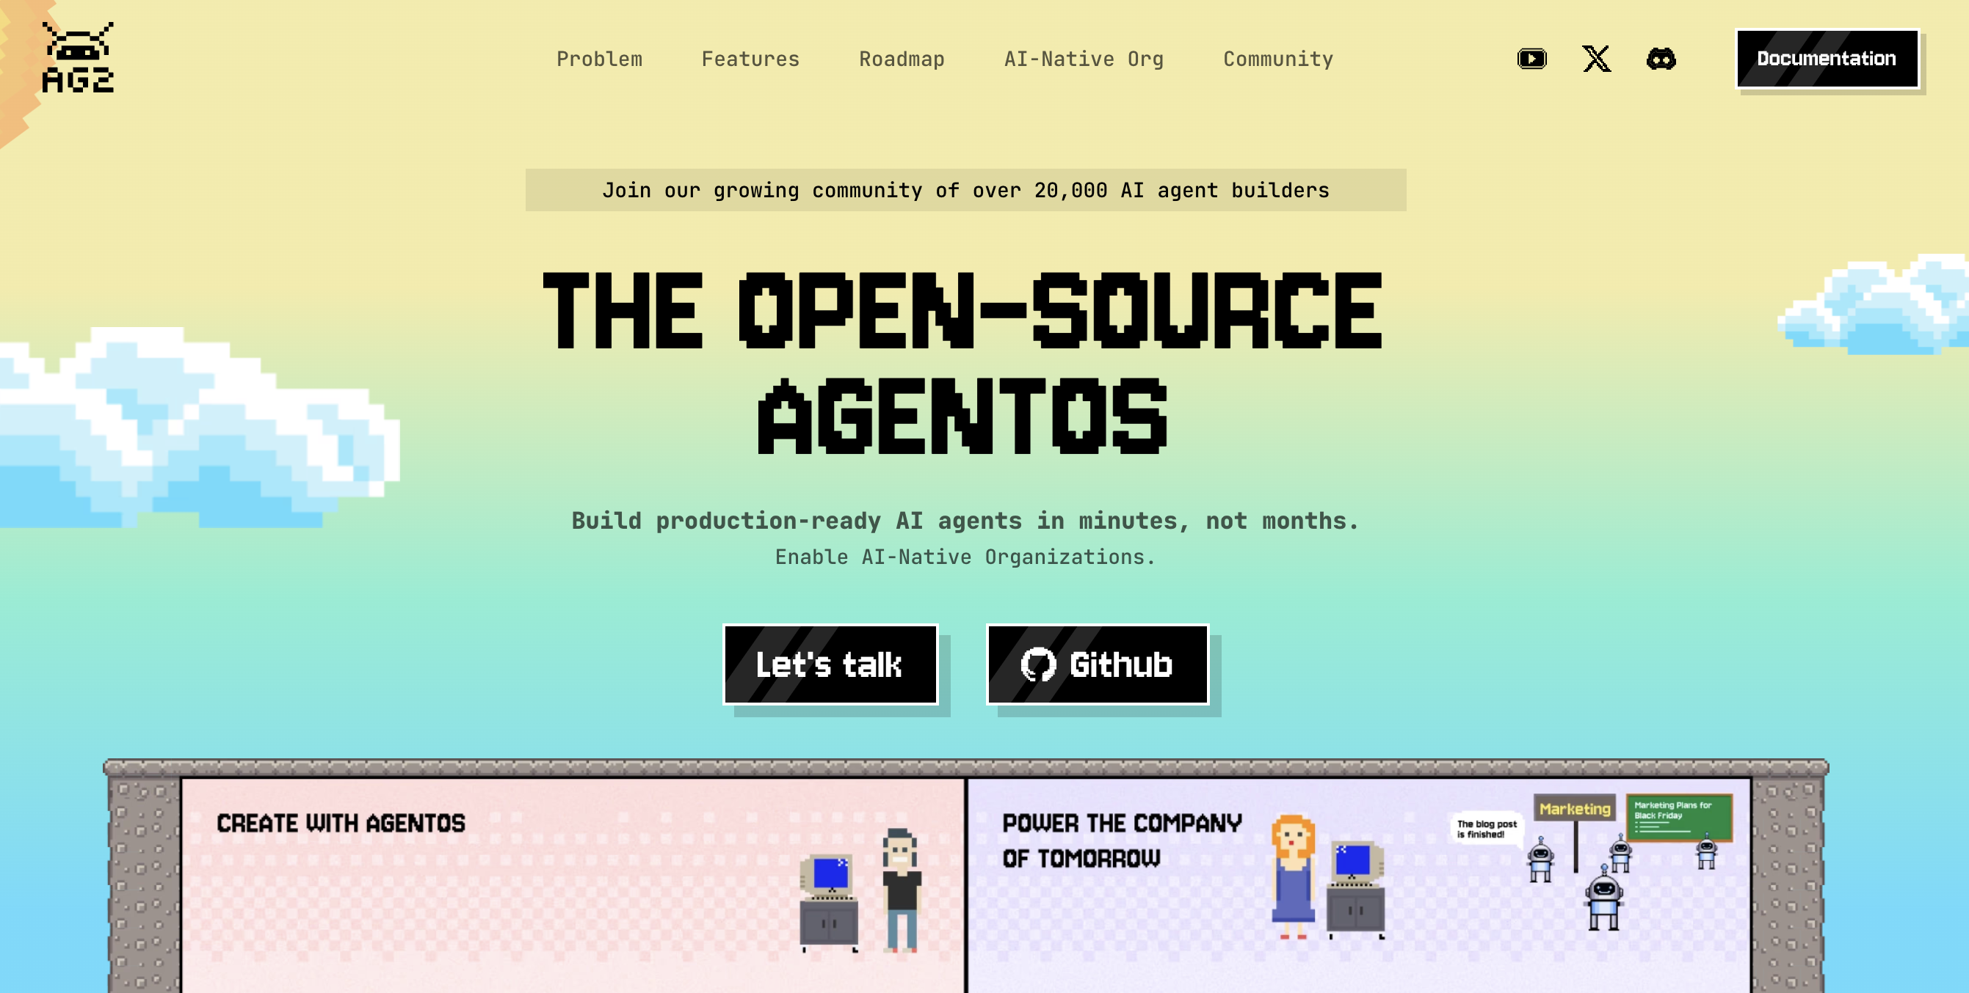
Multi-agent frameworks

Slide 12
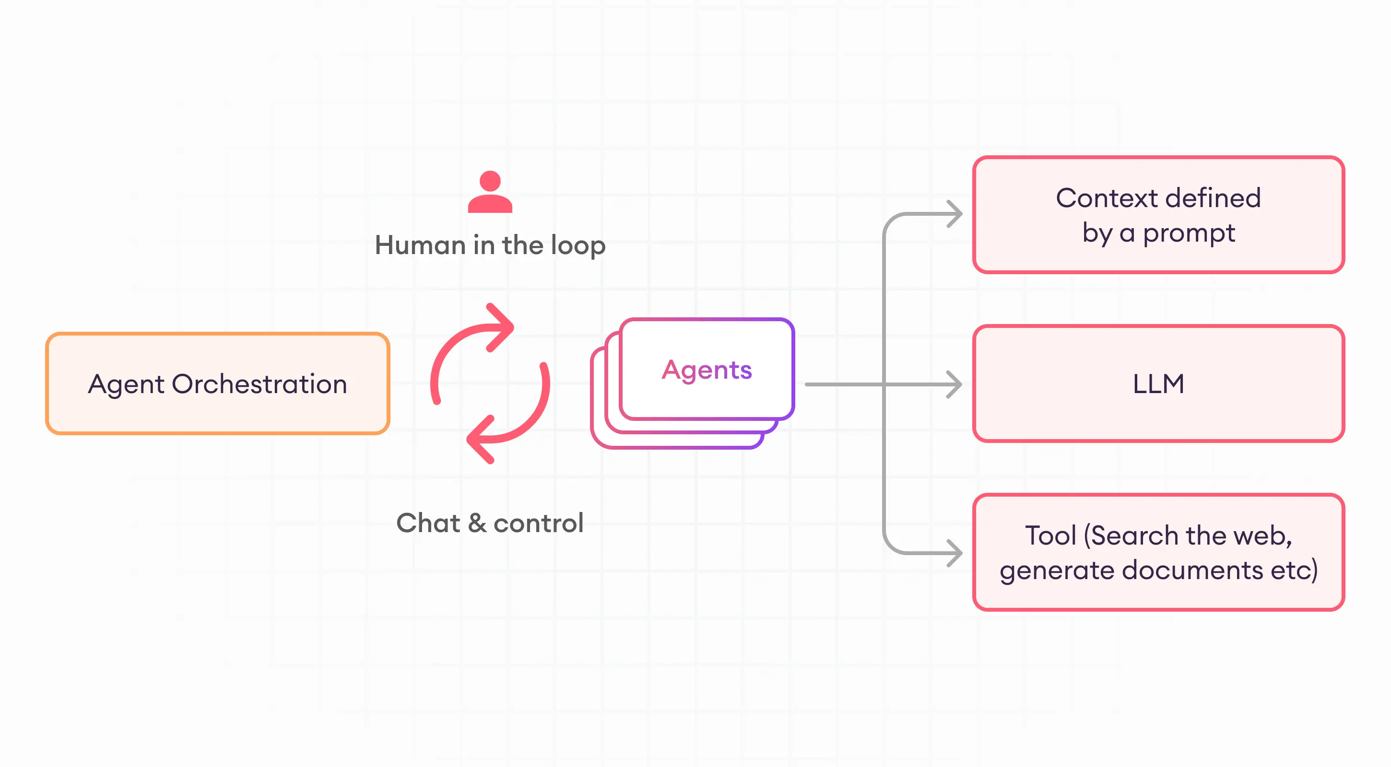
AG2
Installing AG2
Basic Concepts
LLM Configuration
ConversableAgent
Human in the Loop
Agent Orchestration
Tools
Structured Outputs

Slide 13
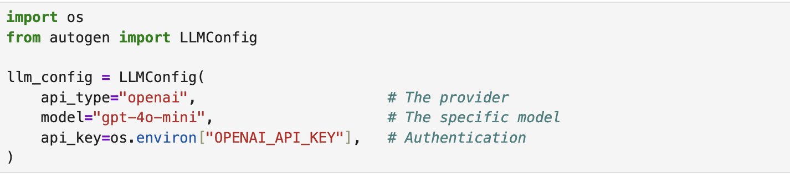
LLM configuration
LLM Configuration controls how an agent:
Connects to and authenticates with language model providers
Selects models and sets parameters
Thinks, reasons, and generates responses
AG2 supports a variety of LLM providers
Cloud Models: OpenAI, Anthropic, Google (Gemini), Amazon (Bedrock), Mistral AI, Cerebras, Together AI, and Groq
Local Models: Ollama, LiteLLM, and LM Studio

Slide 14
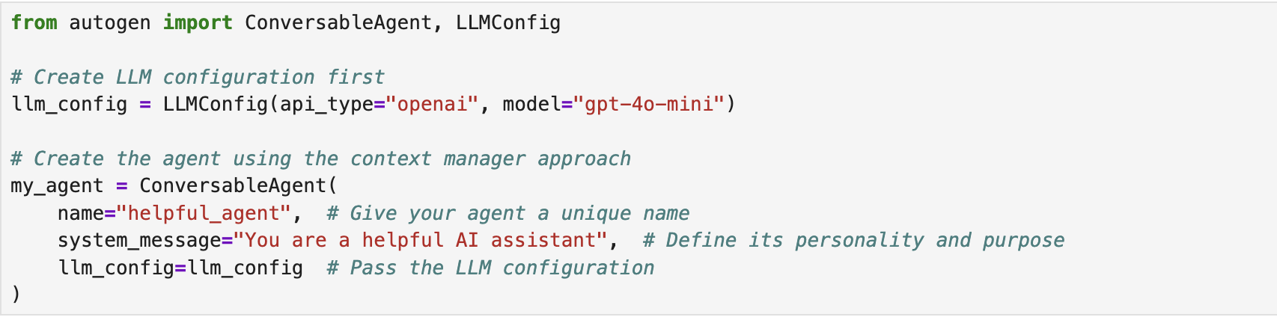
ConversableAgents: Building Intelligent Agents
The ConversableAgent is the fundamental building block of AG2.
With an LLM configuration providing its thinking power, a ConversableAgent can:
Communicate with other agents and humans
Process information and generate responses
Follow instructions defined in its system message
Execute tools and functions when needed
Notes:
GO to

Slide 15
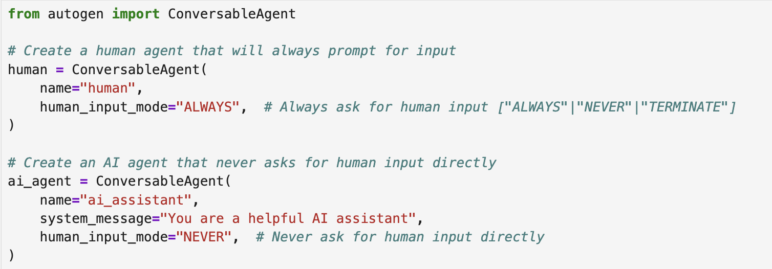
Human in the loop: Adding human oversight
A powerful pattern that enables AG2 agents to collaborate with humans throughout the workflow.
Humans can:
Oversee the entire process
Intervene when necessary
Inject new queries dynamically
Notes:
GO to

Slide 16
ConversableAgents: Building Intelligent Agents
In Notebook 1&2 we’ll see how to:
load and set openai api key
Define LLM configuration
Build our first agent with AG2
Interact with the agent using run() and process()
add human in the loop capacity
Notes:
GO to

Slide 17
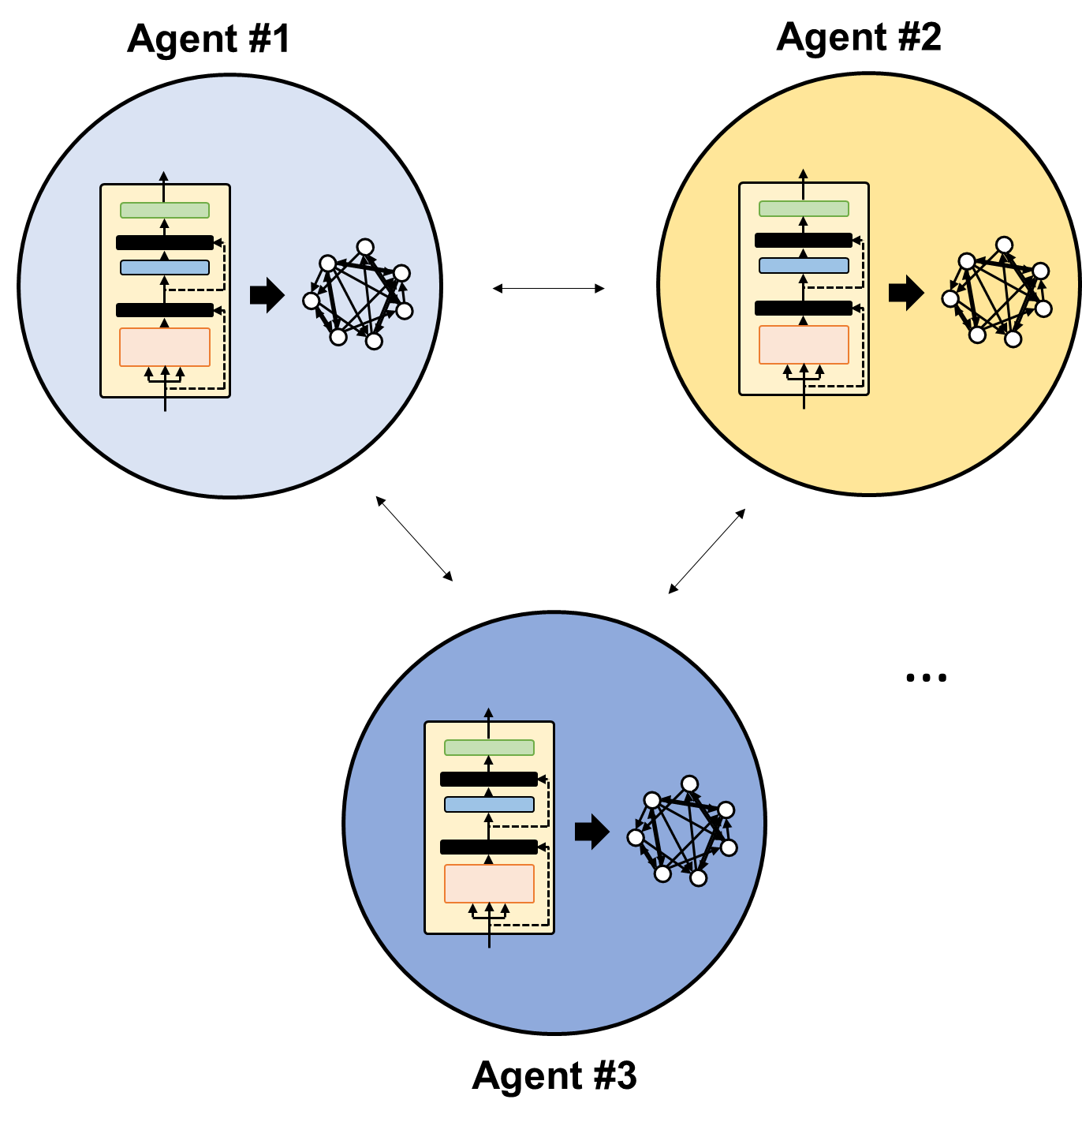


Agent Orchestration: Coordinating Multiple Agents
Why multi-agent systems?
Using multiple "simple" unitary components to build out higher complexity
Improving LLMs through reflection, planning, and tool use strategies to produce more accurate results
Interact to model “thought” – iterations, critique, improvements
T. Dreyer et al. PNAS (2024)
We find that when ants work in groups, their performances rise significantly…

Slide 18
Overview
Two-agent chat: The simplest form of conversation pattern where two agents chat back-and-forth with each other.
Sequential chat: A sequence of chats, each between two agents, chained together by a carryover mechanism (which brings the summary of the previous chat to the context of the next chat). Useful for simple sequential workflows.
Group chat: A chat between more than two agents with options on how agents are selected.

Slide 19
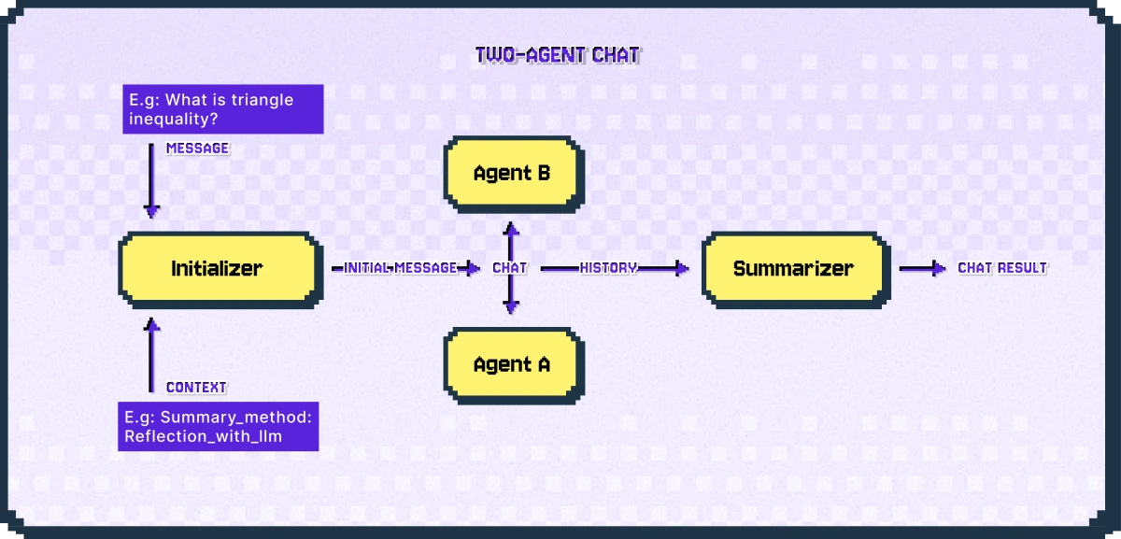
Two Agent Chat
Two-agent chat is the simplest form of a conversation pattern.
Start a two-agent chat using the initiate_chat of every ConversableAgent agent
Notebook 3&4: Build a simple two-agent chat between two agents.
We learn how the summay_method parameter of the initiate_chat works in summarizing the history of the chat.

Slide 20
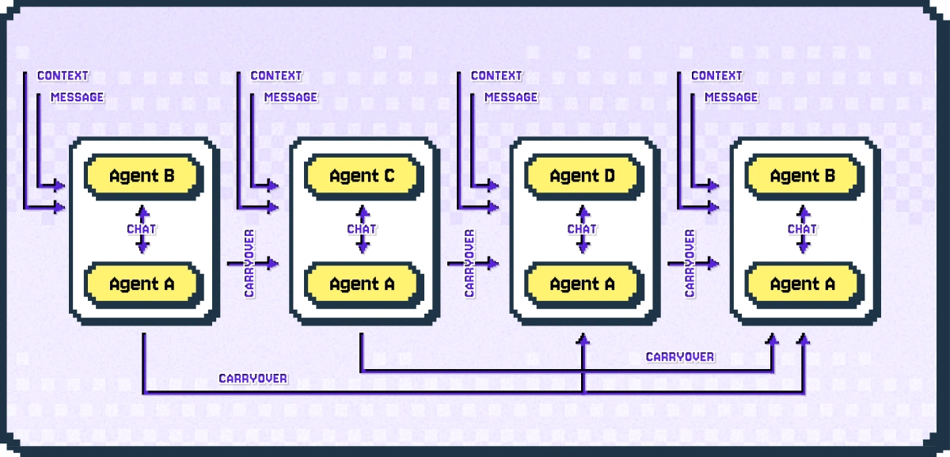
Sequential Chat
A sequence of chats between two agents
Useful for complex tasks that can be broken down into interdependent sub-tasks.
The chats are chained together by a mechanism called carryover.
The summary of the conversation between two agents becomes a carryover for the next two-agent chat

Slide 21
Sequential Chat
Notes:
Carryover accumulates as the conversation moves forward, so each subsequent chat starts with all the carryovers from previous chats.
Notebook 5: Build a sequential chat

Slide 22
Group chat
Specialized expertise: Each agent can focus on what is does best, creating a team of specialists
Dynamic collaboration: Agents can interact with each other and respond to new information as it emerges
Flexible handoffs: Control can move between agents based on context, conversation state, or explicit directions
Shared context: All agents work within the same conversation context, maintening continuity
Scalable complexity: Easily add new capabilities by introducing specialized agents rather that making existing agents more complex

Slide 23
Group chat
Implementing a group chat in AG2 is a simple three-step process
First, build the agents
Then, create a pattern that defines how agents will interact
Finally, initialize the group chat using the pattern

Slide 24
Patterns
The pattern defines the orchestration logic - which agents are involved, who speaks first, and how to transition between agents.
AG2 provides several pre-defined patterns to choose from:
DefaultPattern: A minimal pattern for simple agent interactions where the handoffs and transitions needs to be explicitly defined
AutoPattern: Automatically selects the next speaker based on conversation context
RoundRobinPattern: Agents speak in a defined sequence
RandomPattern: Randomly selects the next speaker
ManualPattern: Allows human selection of the next speaker
The easiest pattern to get started with is the AutoPattern, where a group manager agent automatically selects agents to speak by evaluating the messages in the chat and the descriptions of the agents.

Slide 25
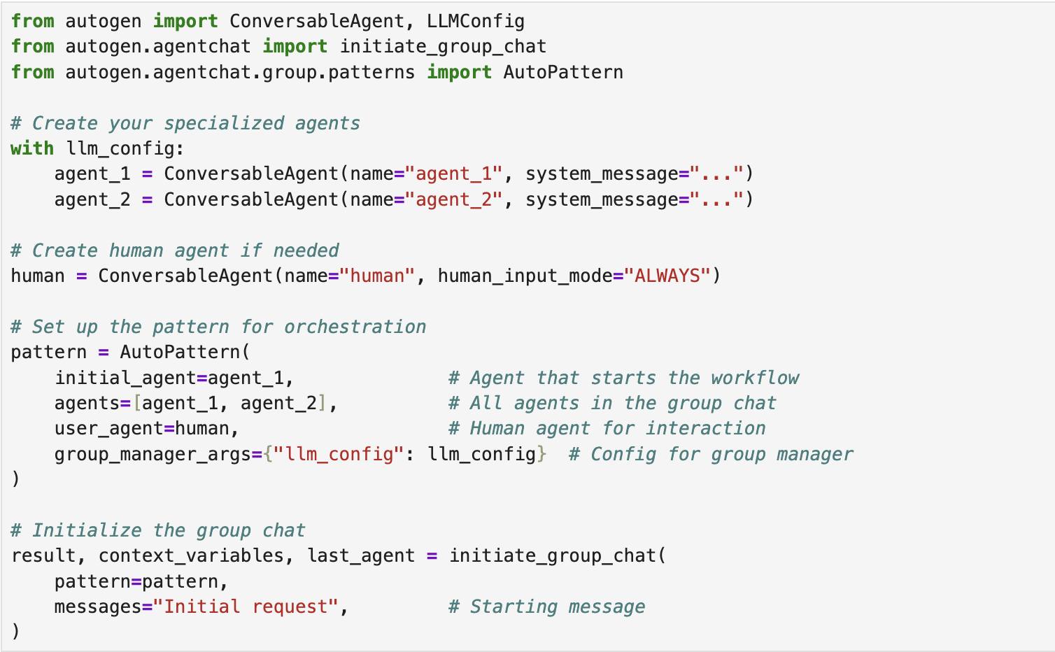
Pattern implementation

Slide 26
Agent Orchestration: Coordinating Multiple Agents
In Notebook 6-9 we’ll see how to build a multi-agent system with AutoPattern.

Slide 27
Tools: Extending Agent Capabilities
Tools provide a structured way for agents to interact with the outside world.
Think of tools as specialized functions that agents can choose to use when appropriate.
With tools we provide AI with ability to generate its own data or retrieve knowledge from different sources
Tool usage in AG2 follows a two-step process:
Selection: An agent (driven by its LLM) decides which tool is appropriate based on the given task
Execution: A separate executor agent invokes the tool and returns the results

Slide 28
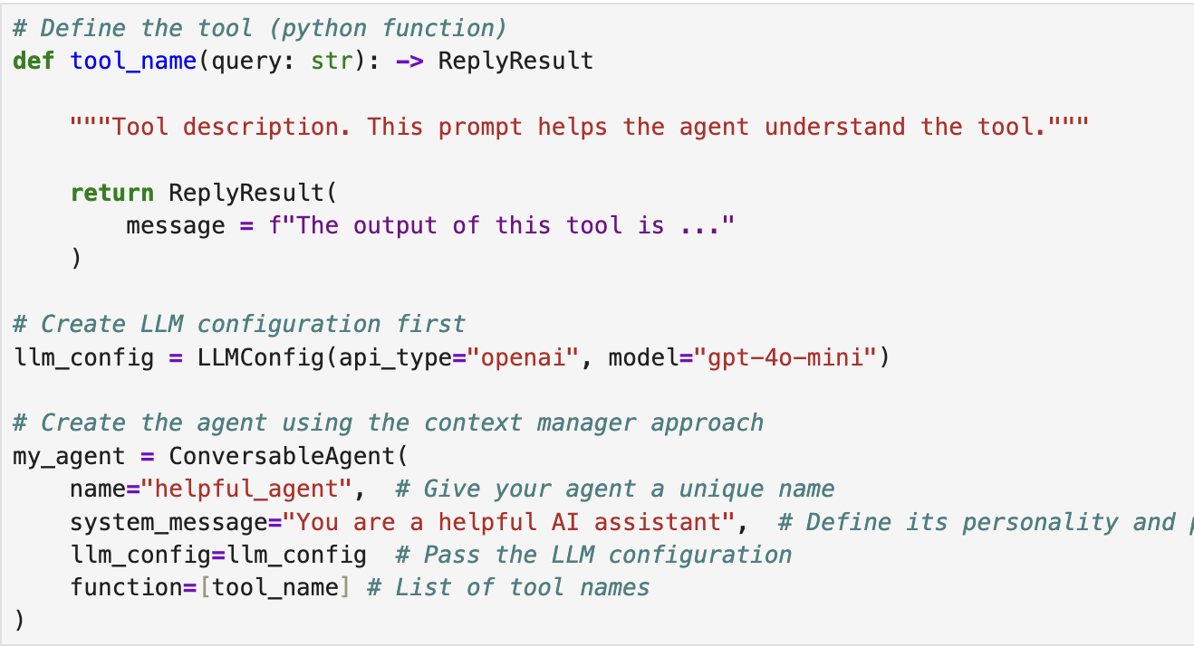
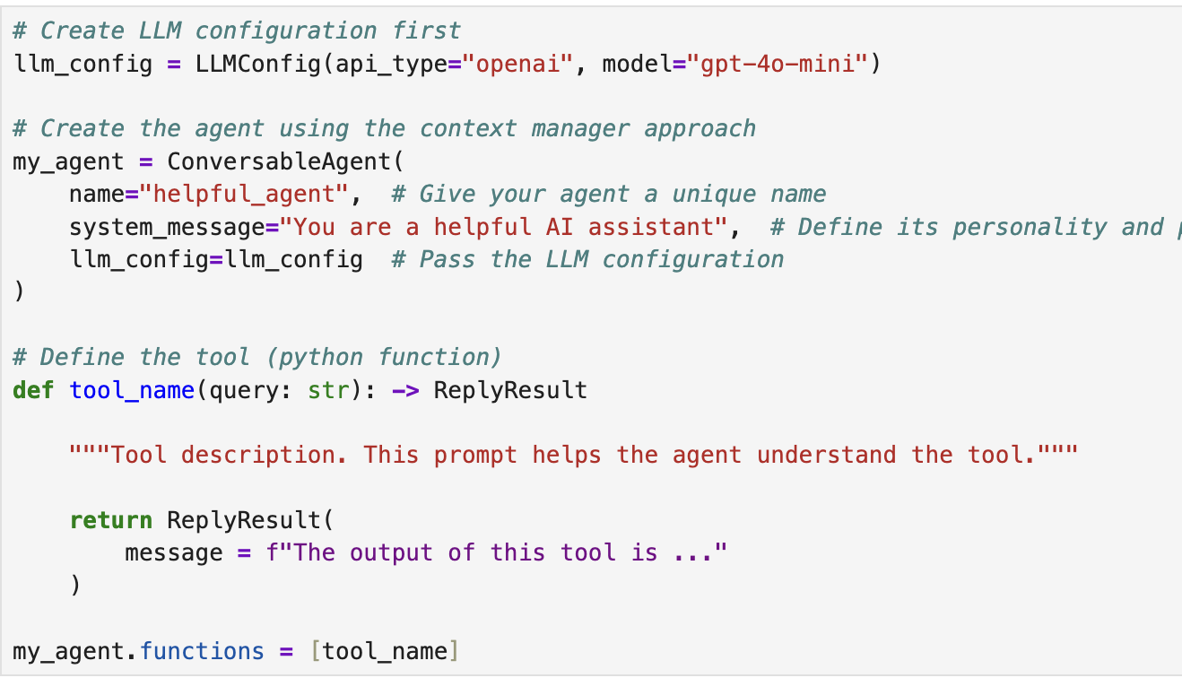
Enhancing multi-agent system with tools
Empowering a group chat in AG2 with tools
Define the tools
Then, build the agents and assign the tools
Then, create a pattern that defines how agents will interact
Finally, initialize the group chat using the pattern

Slide 29
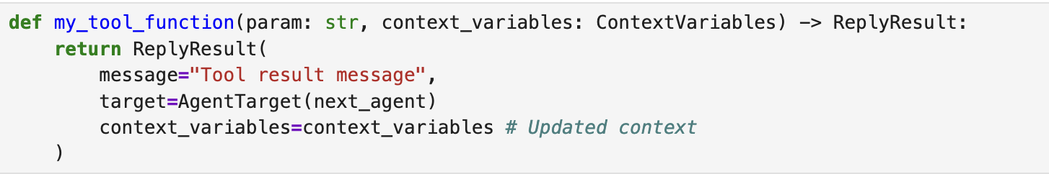
Enhancing multi-agent system with tools
Each tool function can return a ReplyResult
In Notebook 10 we first create a multi-agent system for tech support.
Then, in Notebook 11, we’ll see how to add tools to our multi-agent system.

Slide 30
Context Variables (overview)
Context Variables are a structured way to store and share information between agents in a group chat. They act as a persistent memory that:
Maintains state throughout the entire conversation
Is accessible to all agents in the group
Can be read and updated by any agent or tool
Stores data in a key-value format
In this section you will learn how to:
Create and initialize context variables
Read from and write to the shared context
Pass information between agents
Use context variables with tools to create more powerful workflows

Slide 31
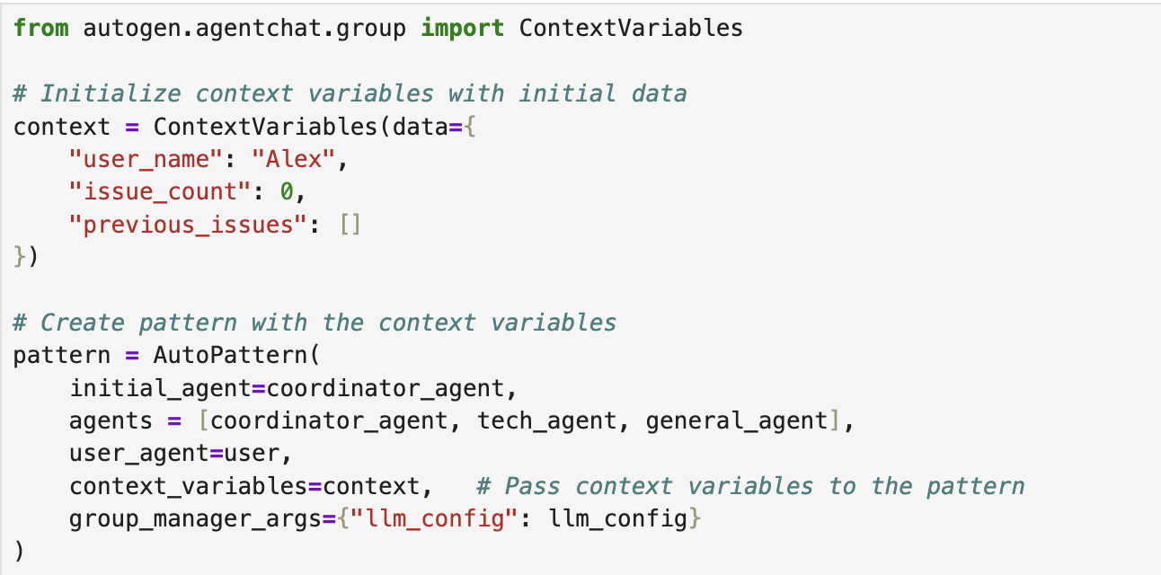
Context Variables (implementation)
Context variables in AG2 are implemented through the ContextVariables class, which provides a dictionary-like interface to store and retrieve values:
Creating and Initializing Context Variables

Slide 32
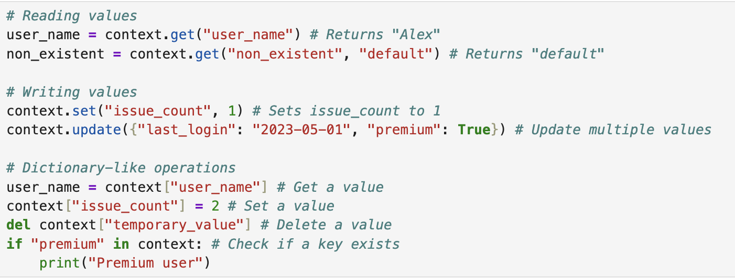
Context Variables (implementation)
Reading and Writing Context Values

Slide 33
Context Variables (implementation)
Reading and Writing Context Values

Slide 34
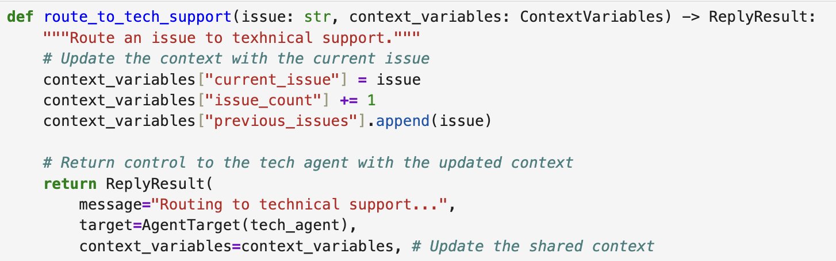
Context Variables (implementation)
Persistent across agent transitions
One of the most powerful features of context variables is their persistence across agent transitions. When control passes from one agent to another, the context variable go with it, maintaining the shared state.
Note:
You should always define a tool to update the context variables.

Slide 35
Context Variables (implementation)
In Notebook 12 we’ll see how to enhance our tech support system with ContextVariables.

Slide 36
Handoffs (overview)
Handoffs are the essential mechanism that controls how agents interact and pass control to each other in a group chat. If tools represent what agents can do and context variables represent what they know, handoffs determine where they go next.
In multi-agent systems, you need to carefully control which agent speaks when and handoffs provide you this control.
In this section you will learn how to:
Define explicit handoff conditions between agents
Use context variables to drive dynamic transitions
Implement complex workflows with conditional branching
Combine tolls, context variables, and handoffs for sophisticated agent orchestration

Slide 37
Handoffs (concepts)
Each agent in AG2 has a handoffs attribute that manages transitions from that agent. The handoffs attribute is an instance of the Handoffs class.
When defining a handoff, you specify a transition target – the destination where control should go. AG2 provides several types or transition targets:
Transition Targets:
AgentNameTarget: Transfer control to an agent by name
AgentTarget: Transfer control to a specific agent instance
AskUserTarget: Ask the user to select the next speaker
GroupManagerTarget: Transfer control to the group manager who will select the next speaker
RandomAgentTarget: Randomly select from a list of agents
RevertToUserTarget: Return control to the user agent
StayTarget: Keep control with the current agent
TerminateTarget: End the conversation

Slide 38
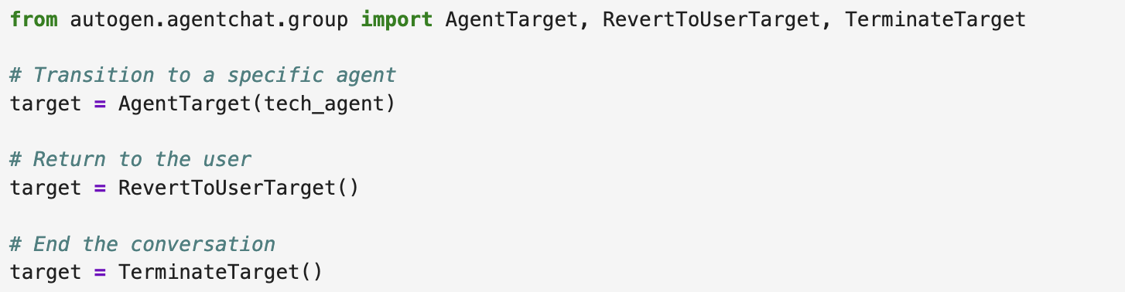
Handoffs (implementation)

Slide 39
Handoffs (implementation)
AG2 offers four main ways to define handoffs:
Explicit handoffs from tools: Direct transitions specified by tool return values
LLM-based conditions: Transitions based on language model’s analysis of messages
Context-based conditions: Transitions based on values in context variables
After-work behavior: Default transition when no LLM or context conditions are met and no tools are called

Slide 40
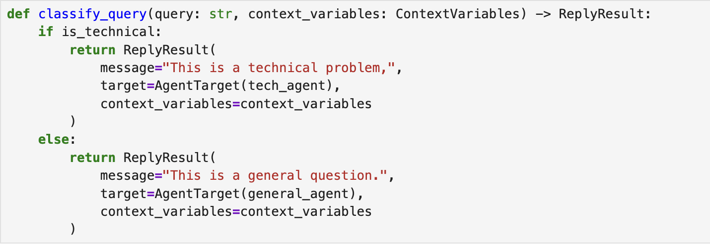
Handoffs (implementation)
Explicit Handoffs from tools
Tools can specify transitions directly in their return values

Slide 41
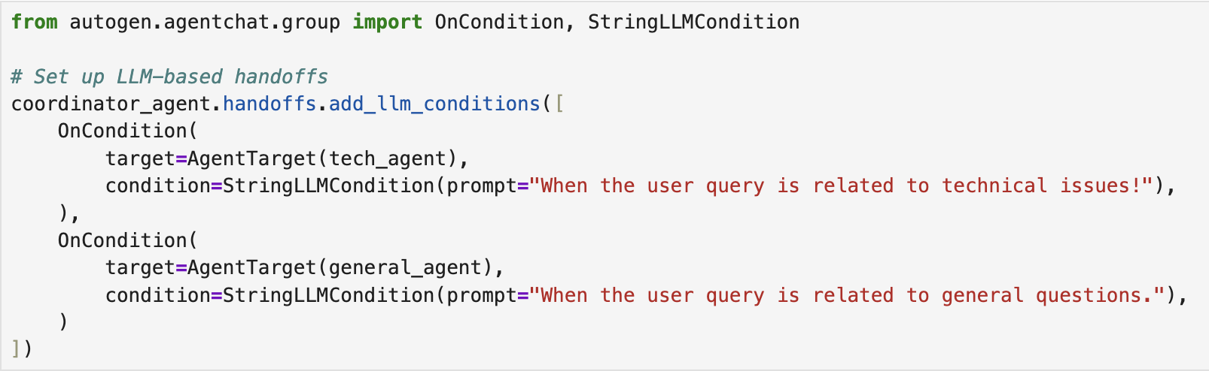
Handoffs (implementation)
LLM-Based Conditions
LLM-based conditions use the LLM to determine when a transition should occur. This is useful when the decision depends on understanding the meaning of messages

Slide 42
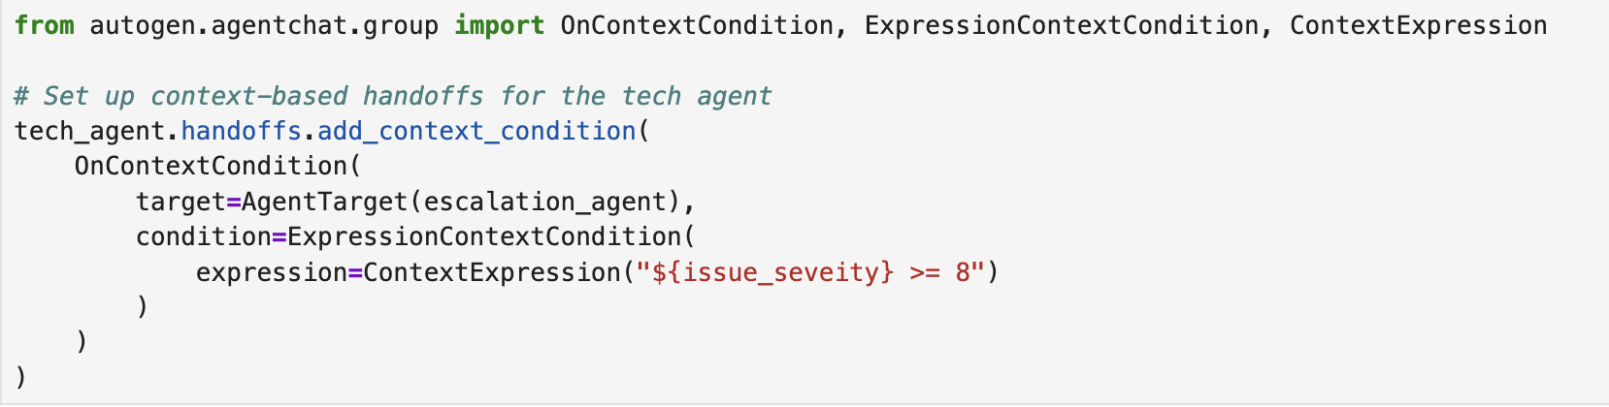
Handoffs (implementation)
Context-Based Conditions
Context-based conditions transition based on the values of context variables. This is ideal for decisions that depend on the system’s state rather than message content.
This example transitions to an escalation agent when the issue_severity context variable is 8 or higher.

Slide 43
Handoffs (implementation)
After-Work Behavior
After-work behavior defines the default transition that occurs after an agent completes its work and no specific condition is met.
In this example, control returns to the user after the tech agent finished speaking, unless another condition routes it elsewhere.

Slide 44
Handoffs (implementation)
In notebook 13, we build a tech support system to demonstrate different types of handoffs and how they work together to create a seamless user experience.

Slide 45
General Guidelines
🔹 Start with a Plan What steps are needed?
How many agents (workers) would you assign?
What should each one do?
🔹 Define the Right Tools
Need external data (web, APIs, files)? ➝ Add tool agents.
Need shared knowledge or memory? ➝ Use context variables.
🔹 Use Handoffs for Complex Tasks
If the task involves multiple stages or roles, structure it with agent-to-agent handoffs.
🔹 Start Small, Then Scale
Begin with a simple setup to test core logic.
Scale to more agents, tools, and coordination once it works.
🔹 Prompt Clearly and Generously
Don’t hesitate to provide detailed instructions—LLMs thrive on well-structured prompts.
Clarify roles, expectations, and outputs explicitly.

Slide 46
Project ideas
AI Study Buddy: An interactive AI tutor that helps students understand concepts, quizzes them, and explains answers in different ways until they understand.
AutoSyllabus: A system that generates an entire course syllabus, lecture content, and slides based on a course title and target audience.
SiteForge Agents: Multi-agent system to design and deploy a website from scratch—UI design, frontend/backend code, and deployment setup—based on user goals.
GrantWriter: A team of agents that draft compelling research or nonprofit grant proposals from a project description, with agents focused on technical writing, budget, impact, and formatting.
EventPlanner AI: Multi-agent assistant that plans events (e.g. conferences or weddings) including venue suggestions, guest list organization, budgeting, and personalized invites.
LLM Dungeon Master: Agents act as game master, player, and narrator to generate a collaborative storytelling game (e.g. D&D-style text adventure).

Slide 47
Project ideas
AutoJournalist: A team of agents that collects news from APIs, summarizes articles, fact-checks, adds commentary, and formats it into a daily briefing or newsletter.
CareerCoachBot: One agent collects the user’s CV, another reviews it, a third generates job suggestions, and a fourth conducts mock interviews.
CodeRefactor Crew: A system where one agent analyzes legacy code, another improves it, one adds documentation, and another tests for bugs or vulnerabilities.
Startup Simulator: Agents play roles of CEO, CTO, marketing lead, and investor to simulate how a startup could pitch, plan, and iterate on a business idea.
LegalDoc Builder: Agents generate custom contracts (e.g. NDA, lease, freelance agreements), with one focused on legality, one on clarity, one on formatting, and one on risk.
HealthCoach: A multi-agent system where a symptom analyzer, diagnosis assistant, treatment planner, and compliance tracker work together to guide patients through symptom checking, care suggestions, and follow-up support.

